Slide 1
Energy Model of EGFR Signaling Pathway
Zarifeh Heidari
June 2, 2022

Slide 2
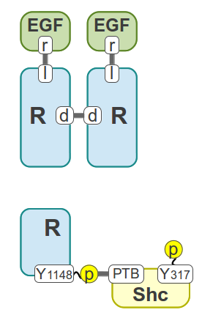
Step 1
Model Components:
EGF, EGFR, Shc
Kholodenko Model
16 Parameters
Energy-Base Model
12 Parameters

Slide 3
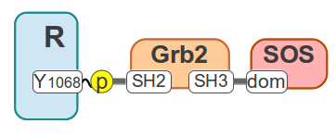
Step 2
Model Components:
EGF, EGFR, Shc, Grb2, SOS
Not considering the
connection Of
Shc and Grb2
Kholodenko Model
24 Parameters
Energy-Base Model
19 Parameters

Slide 4
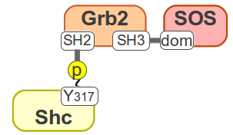
Step 3
Model Components:
EGF, EGFR, Shc, Grb2, SOS
considering the
connection Of
Shc and Grb2
Kholodenko Model
40 Parameters
Energy-Base Model
24 Parameters

Slide 5
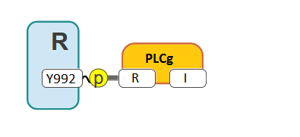
Step 4
Model Components:
EGF, EGFR, Shc, Grb2, SOS,
PLCg
Kholodenko Model
50 Parameters
Energy-Base Model
28 Parameters

